Slide 1
Industry-University Collaboration Project
SKKU IoT Lab
April 26, 2022

Slide 2
Contents
Project background
Project objectives
Plan
Reference

Slide 3
Project background

Slide 4
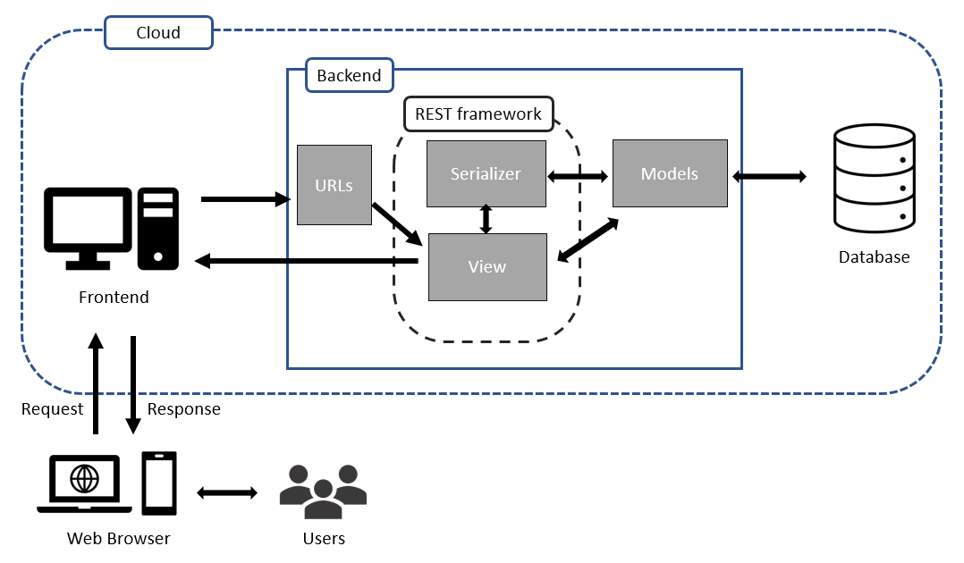
Influencer web platform
Project background

Slide 5

Influencer web
Project background
Link: https://www.samplelife.co.kr/

Slide 6

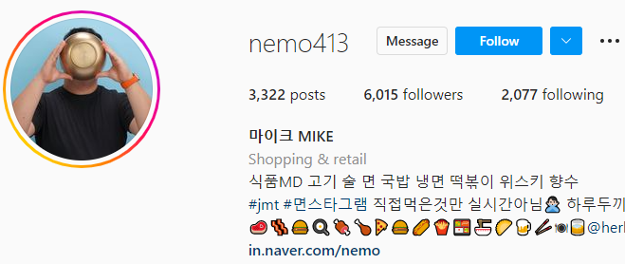


Influencer web
Project background
Influencer apply for
the campaigns
Client Part
Matching
Part
Influencer Part
Category:
Category:
Food
Clients upload
the campaigns
food
Sports
IT
IT
Give the best
matching for
advertisement
…
Influencers from
Instagram, YouTube …

Slide 7
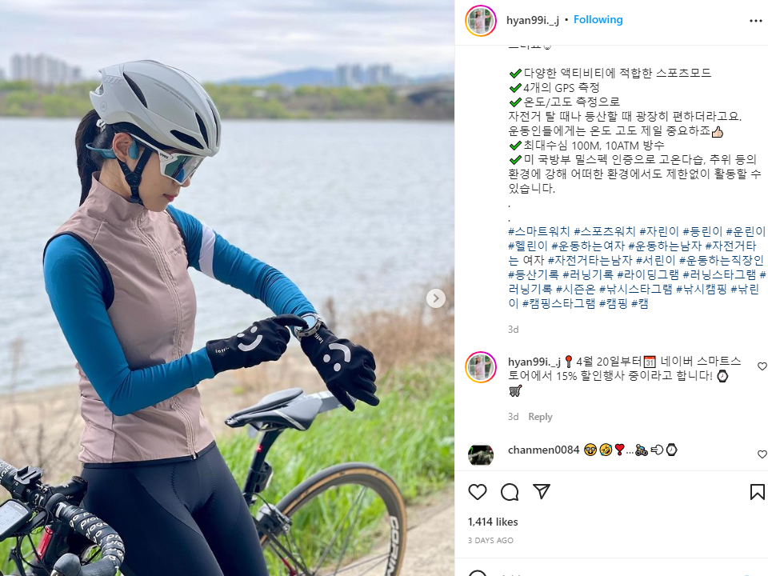
Influencer Analysis
Project background
Image
Caption
Category:
Text Classification
Sports
Image Classification

Slide 8
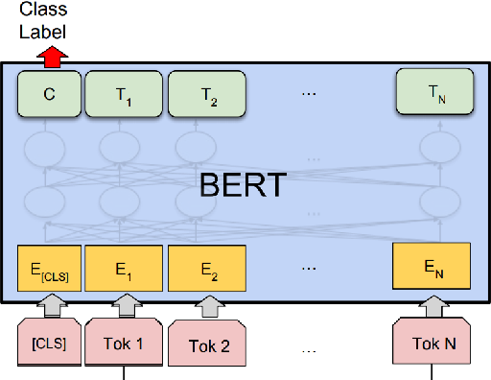

Influencer Analysis
Project background
Category
Text Classification
화장품
패션
요리, 음식
여행, 아웃도어
인테리어
엔터테인먼트
육아
Media Caption
IT
Hashtag
자동차
Comments
헬스, 피트니스
…
In our project, we used KoBERT model for Korean text.
반려동물
Source: https://github.com/SKTBrain/KoBERT

Slide 9
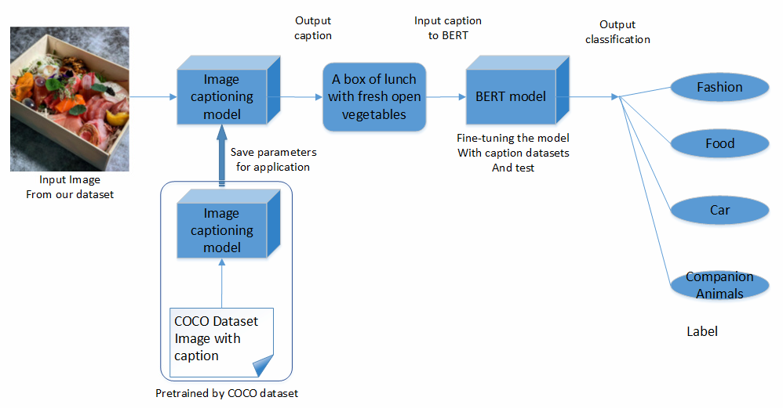
Influencer Analysis
Project background
Image Classification
Combine
image
captioning model
and BERT
model
Image from
influencers

Slide 10
Project objectives

Slide 11
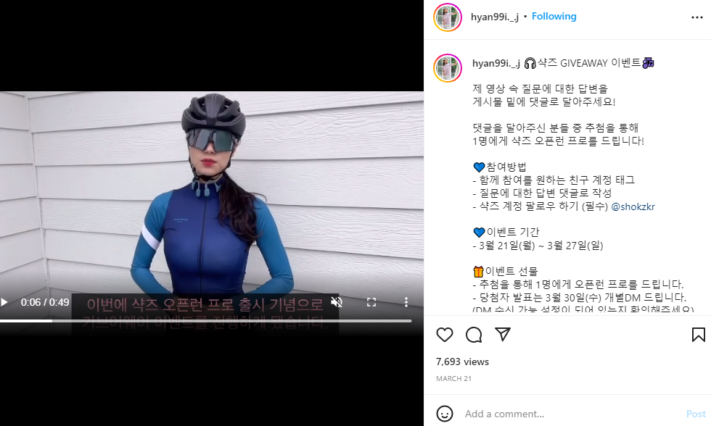
Video classification
Project Objectives
Category:
Video Classification
Sports

Slide 12
Video classification
Project Objectives
Video data → sequence of images
Both spatial and temporal features
Objects in images
Track object activities and movement
Background environment

Slide 13
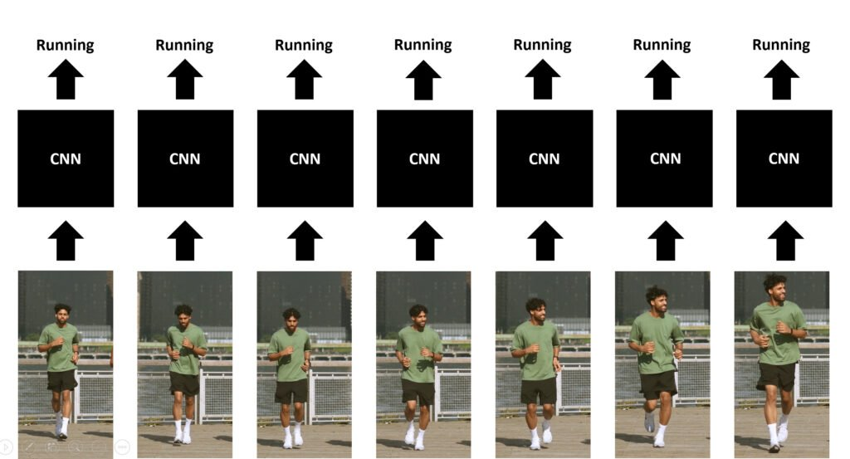
How to do Video classification
Project Objectives
Approaches:
Single-Frame CNN
Source: https://learnopencv.com/introduction-to-video-classification-and-human-activity-recognition/

Slide 14
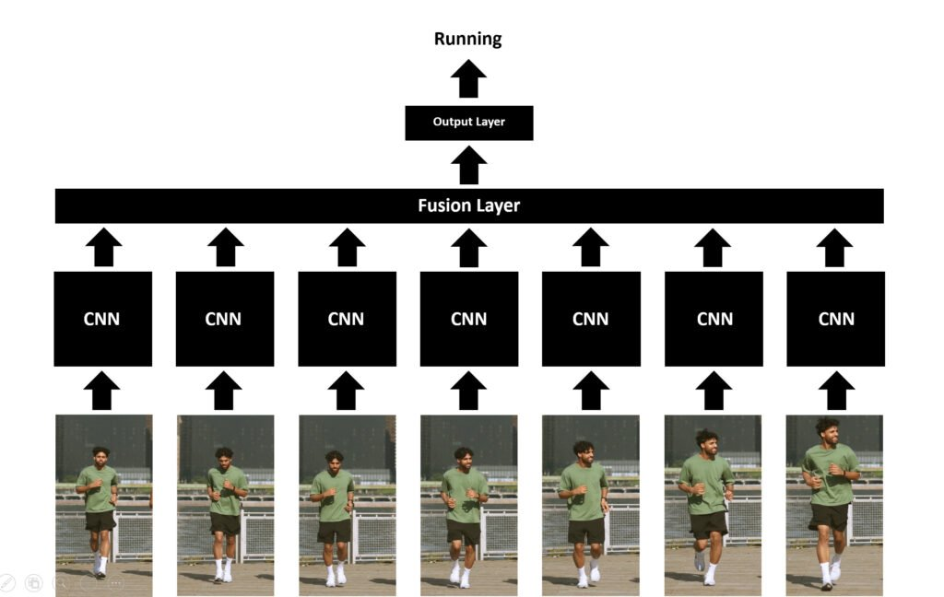
How to do Video classification
Project Objectives
Approaches:
Single-Frame CNN
Late Fusion
Source: https://learnopencv.com/introduction-to-video-classification-and-human-activity-recognition/

Slide 15
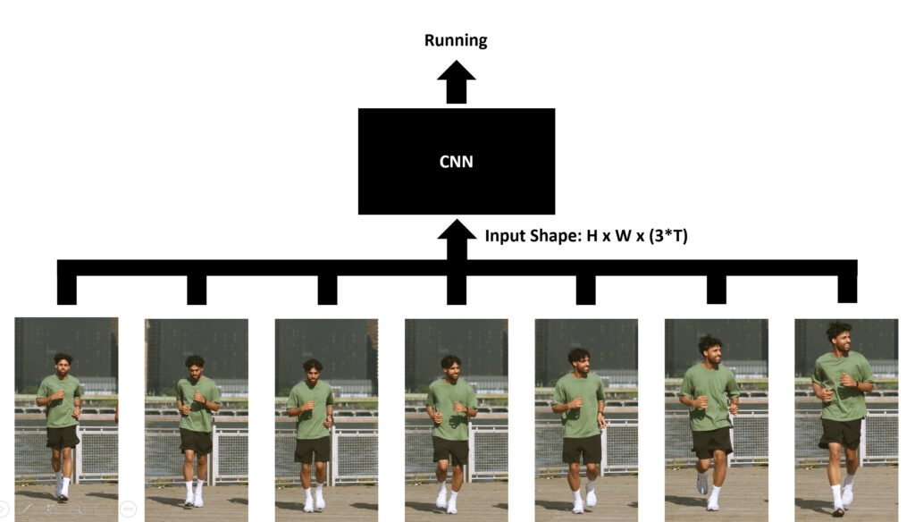
How to do Video classification
Project Objectives
Approaches:
Single-Frame CNN
Late Fusion
Early Fusion
Source: https://learnopencv.com/introduction-to-video-classification-and-human-activity-recognition/

Slide 16
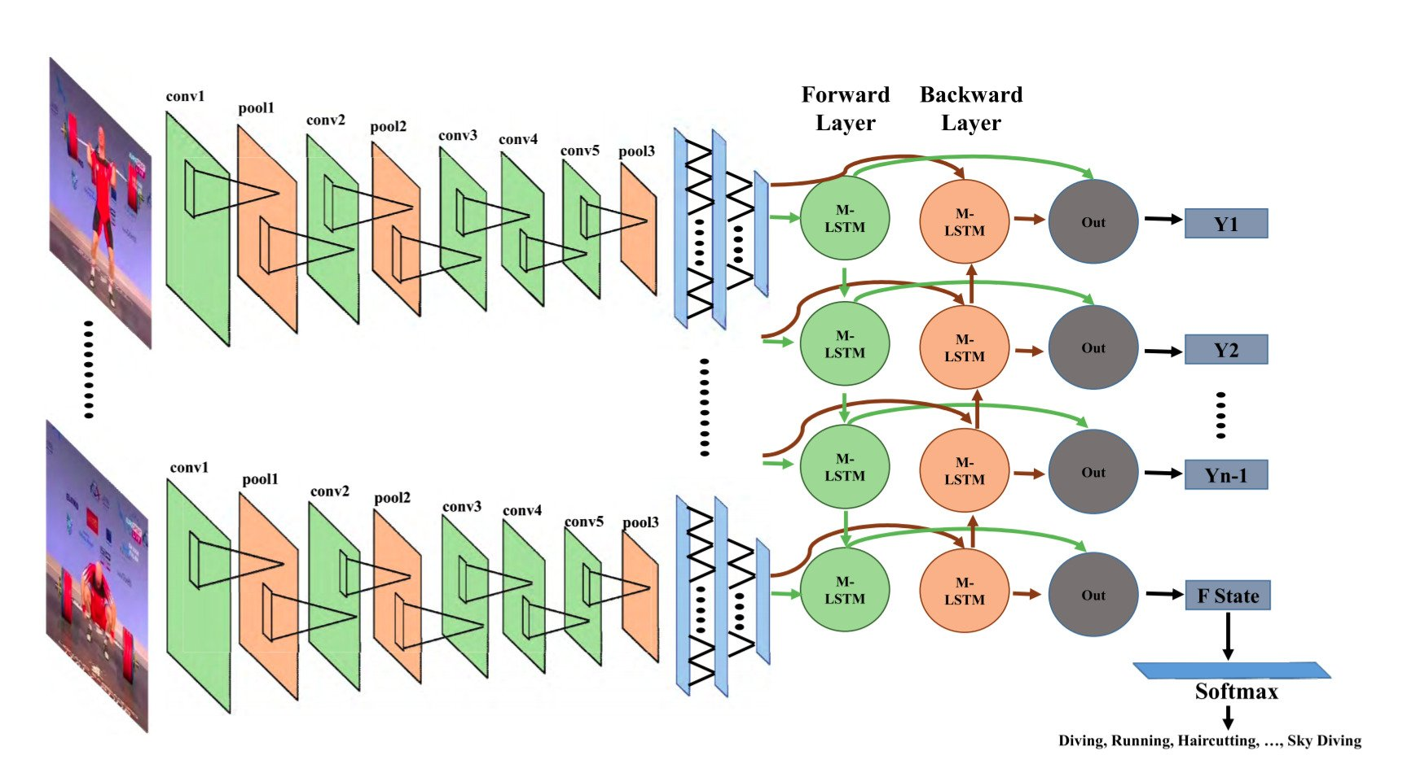
How to do Video classification
Project Objectives
Approaches:
Single-Frame CNN
Late Fusion
Early Fusion
Using CNN with LSTM
Source: https://learnopencv.com/introduction-to-video-classification-and-human-activity-recognition/

Slide 17
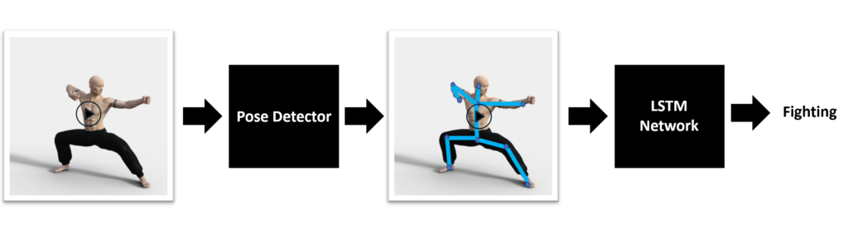
How to do Video classification
Project Objectives
Approaches:
Single-Frame CNN
Late Fusion
Early Fusion
Using CNN with LSTM
Using Pose Detection and LSTM
….
Source: https://learnopencv.com/introduction-to-video-classification-and-human-activity-recognition/

Slide 18
How to do Video classification
Project Objectives
Datasets:
YouTube-8M: https://research.google.com/youtube8m/
Kinetics: https://www.deepmind.com/open-source/kinetics
Charades: https://prior.allenai.org/projects/charades
…

Slide 19
Plan

Slide 20
Monthly Plan
Plan
May
June
July
Aug
Sep
Oct
Nov
CNN,
LSTM,
RNN,
Transformer…
Python
Pytorch
Tensorflow
…
learning existing datasets and model
Collecting our own datasets
And labeling them
Looking for appropriate model to classify
them
Optimize
the
performance
Integration
to influencer web platform
Basic
knowledge
Project Test
Project in progress

Slide 21
Reference

Slide 22
Link
Reference
1. Stanford computer vision : C231
Link: https://www.youtube.com/watch?v=vT1JzLTH4G4
2. Latest paper related video classification:
Link: https://paperswithcode.com/task/video-classification/latest
3. Video Classification with Transformers:
Link: https://keras.io/examples/vision/video_transformers/

Slide 23
Thank you

